Slide 1



Synchrony in the Forest: The Ecology of Masting Trees
Xiaomao Wang
Comprehensive Exam
Temporal Ecology Lab
Faculty of Forestry, University of British Columbia
Nov 21 2025
Notes:
Hi everyone! My name is Mao, and I’m a PhD student in Lizzie’s lab.

Slide 2
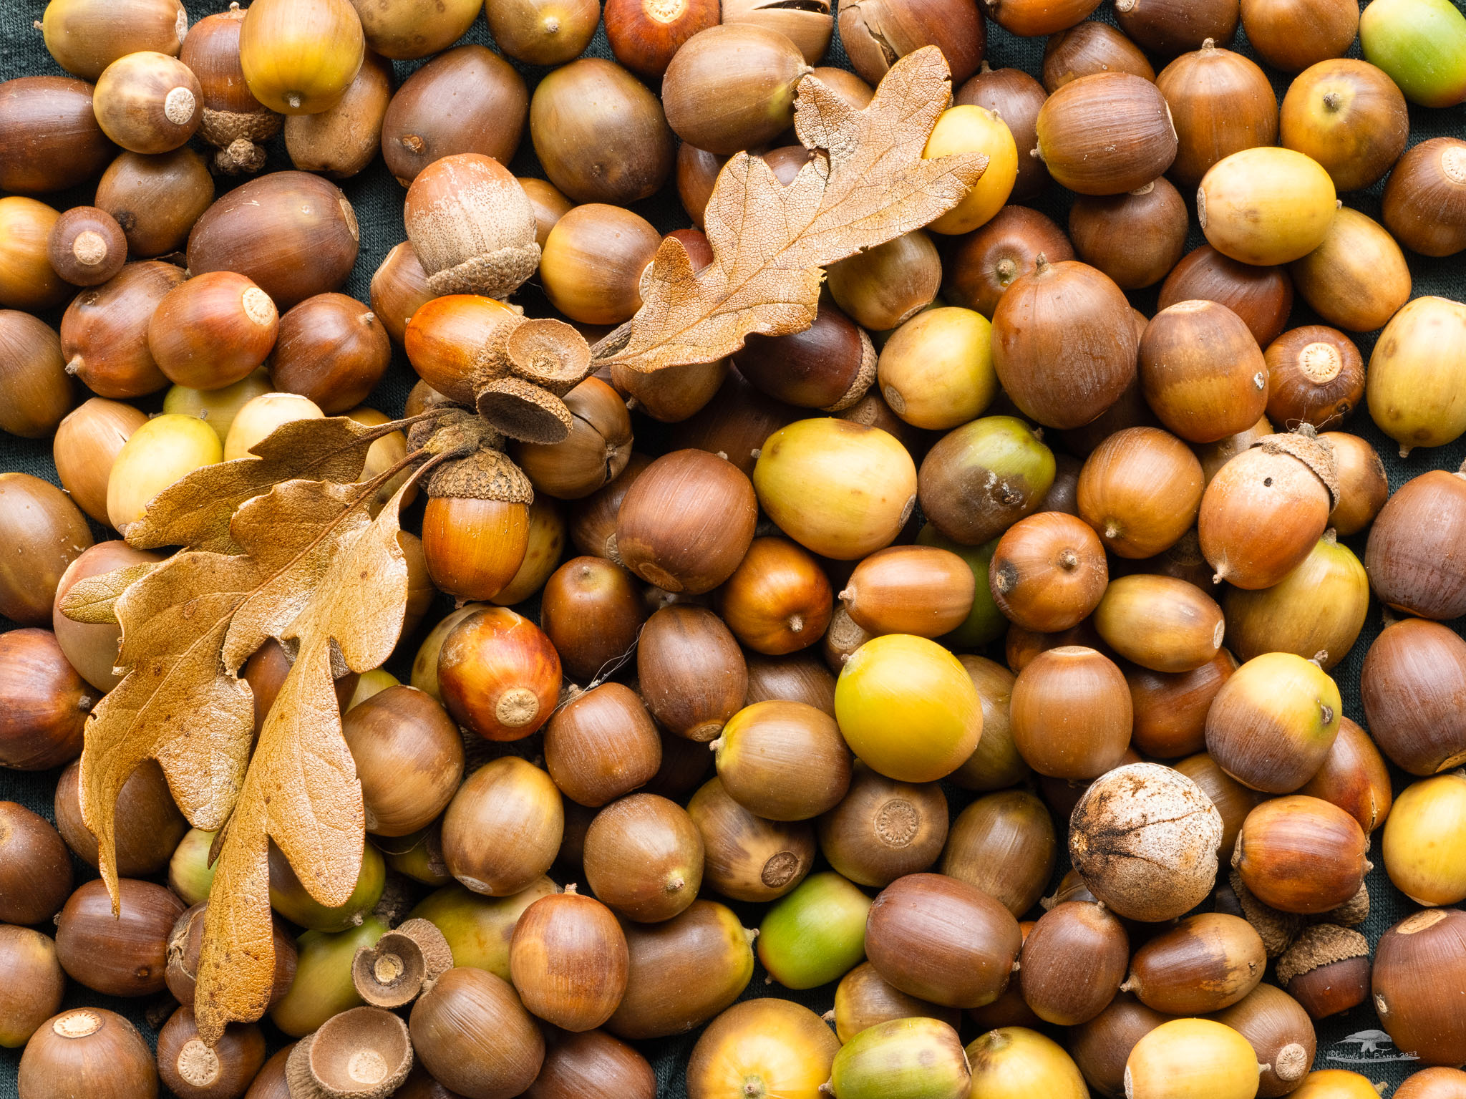
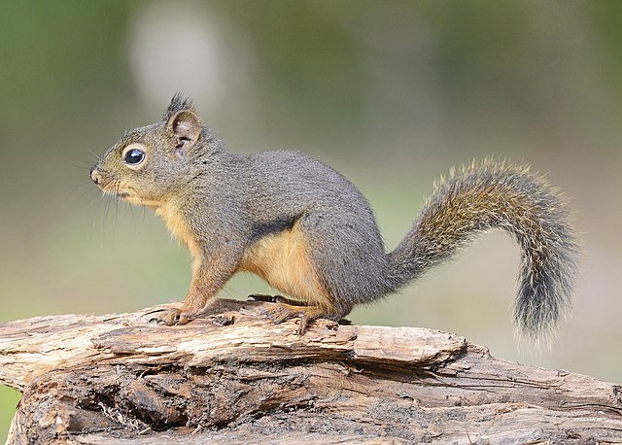
Mast year
A specific pattern of reproduction
Population level
High variability from year to year
Notes:
In 2023, the squirrels in Victoria were extra busy. The garry oaks in this region seemed to produce tons of acorns all over the city. People complained that the sound of falling acorns was like machine guns pelting their roofs, and you can see acorns making a carpet on the ground. This is what people usually call a mast year, when the squirrels’ dream come true.
So, what’s the definition of masting? When we talk about masting, we’re not just describing trees that produce a lot of seeds — we’re describing a specific pattern of reproduction. Masting is a reproductive strategy that occurs at the population level, characterized by high variability in reproduction from year to year.

Slide 3


Characteristics of masting
Mast
Non-Mast
Interannual variation
Synchrony
Mast year
Mast year + 1
Mast year
y+1
y+2
Mast year
Temporal autocorrelation
Frequency
Notes:
It has four main characteristics:
Interannual variation: Seed production varies in magnitude across years, so we are seeing this variation in mast year and non-mast year.

Slide 4
Characteristics of masting
Mast
Non-Mast
Interannual variation
Synchrony
Mast year
Mast year + 1
Mast year
y+1
y+2
Mast year
Temporal autocorrelation
Frequency
Notes:
Synchrony: reproduction is synchronized across a population

Slide 5
Characteristics of masting
Mast
Non-Mast
Interannual variation
Synchrony
Mast year
Mast year + 1
Mast year
y+1
y+2
Mast year
Temporal autocorrelation
Frequency
Notes:
Temporal autocorrelation: a mast year is usually followed by a non-mast year

Slide 6
Characteristics of masting
Mast
Non-Mast
Interannual variation
Synchrony
Mast year
Mast year + 1
Mast year
y+1
y+2
Mast year
Temporal autocorrelation
Frequency
Notes:
Frequency: masting can occur regularly (every 2–3 years) or irregularly (every 3–7 years)
Masting it is very important to understand masting, but it is yet still not very well understood, why is that the case? Because it is a complex phenomenon that involves not just individual trees, but entire populations, communities, and even ecosystems. To understand it better, let’s look at the first piece of the puzzle.

Slide 7






Why do trees mast?
Predation satiation
Pollination coupling
Resource matching （Resource budgeting)
Environmental cues
Notes:
Why do trees mast? Scientists have proposed many different hypotheses to explain this, coming from different perspectives and stages of reproduction.
The most famous is the predation satiation hypothesis, which suggests that trees mast to overwhelm seed predators in mast years and starve them in non-mast years. By manipulating predator population sizes, trees increase the chances that some seeds will survive in a mast year.
Another explanation is pollination coupling — when trees flower more synchronously, pollination efficiency increases, leading to higher reproductive success.
The resource matching hypothesis proposes that a fixed proportion of a tree’s resources go into reproduction each year, so masting reflects years when resources are especially abundant.
A related idea, resource budgeting, suggests that trees accumulate resources over several years and then invest heavily in a single large reproductive event.
Environmental cues — certain environment patterns may trigger masting events.
It’s important to remember that these hypotheses are not mutually exclusive. Multiple mechanisms can interact, and the drivers of masting can differ among species. Understanding what influences masting in a particular species helps us predict how its reproductive dynamics may change over time.

Slide 8

Why don’t tree produce lots of seeds every year?
Limited Resources
Defence
Growth
Reproduction
Storage
Notes:
So, we have different ideas about how masting happens — through evolution, resources, or environmental cues. And another question is: why do trees produce huge numbers of seeds in some years and almost none in others? If more seeds mean more regeneration success, why don’t we observe lots of seeds every year?
The answer is the limited resources. In nature, resources is not always abundant, and these resources must be divided among several key life processes to maintain long-term fitness, which we can group into four categories: defense, growth, reproduction, and storage.
Defense — like producing chemical compounds to deter herbivores or pathogens — usually uses a smaller share of resources and is often triggered only by stress. Storage is important for building up energy reserves, but it’s not always prioritized, especially when resources are scarce.
That leaves growth and reproduction — the most resource-demanding processes and the ones that most directly influence a tree’s long-term survival and success. During a mast year, when large amounts of energy are invested in reproduction, fewer resources remain for other processes, especially the most critical process, growth. This is known as a growth-reproduction trade-off — a long-term resource allocation strategy that helps maintain an individual’s overall fitness.
Understanding how this trade-offs occurs provide insight into the mechanisms behind masting.

Slide 9

Environmental conditions determine resource availability and cues
‘Positive’ environmental events (environmental cues)
‘Negative’ environmental events (environmental vetos)
Masting
Non-masting
Notes:
Of course, trees don’t control how much energy they receive — the environment does. Environmental conditions determine how much resource is produced and stored, and even when cues occur.
In other words, environmental variability sets the stage for resource accumulation and use, and it can also trigger masting events.
Some environmental conditions favor reproduction — we call these environmental cues. For example, a warm, dry spring can enhance pollination and trigger a strong reproductive response, leading to a mast year.
Other conditions act as vetoes — such as a late frost that damages flowers or developing seeds. In those years, trees may redirect resources back to growth instead.
So, the environment doesn’t just influence how much resource is available — it also determines where those resources are allocated.
Bold the text.
Key words
More slides for the first
Slide title to be more specific
(questions I asked)

Slide 10
How possibly could climate change affect mast?
Changes of environmental cues
Different reproductive cycles
Disruption of synchrony
Uncertainties of resources allocation
Notes:
But what happens when those environmental rhythms start to shift?
First, cues like warm, dry springs may become more frequent or less predictable, which could alter the timing or frequency of reproduction. But if these cues are followed by veto events, like late frosts or droughts, seed development may fail, making reproductive investment less successful. Masting could even disappear.
Second, individual trees may start responding differently to changing conditions due to intraspecific variation. That loss of synchrony across the population weakens the advantage of masting, since predator satiation only works when many trees reproduce at the same time.
Finally, climate change could alter resource availability itself — through changes in temperature, rainfall, and soil moisture — affecting how much trees can allocate to life processes in the first place.
So, climate change doesn’t just make masting less predictable. It disrupts the delicate balance among resources, cues, and synchrony that make masting possible. And for some species, masting has already started to decline.

Slide 11



Bigger picture
Forest regeneration
Ecosystem dynamics
Animal populations
Notes:
This brings us to the bigger picture. If masting shapes forest regeneration, wildlife populations, and ecosystem dynamics, then changes in masting pattern could influence everything in the entire ecosystems.
Understanding the mechanisms behind masting — from resources allocation, environmental response, across different species, ecosystems, and environmental contexts — helps us predict how these processes will shift in the future and then we can better predict how forests will respond to the future. It’s a small seed of knowledge with huge ecological consequences.
By looking at reproductive traits, and learning the potential growth-reproduction trade-offs as well as response to environmental factors, my PhD will try to understand the masting from different perspectives and using model to better understand the seed dynamics.

